Slide 1
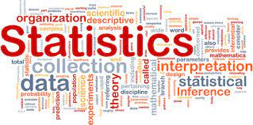
STATISTICS AND ITS TYPES
By SANGEETHA P
7250 BATCH

Slide 2
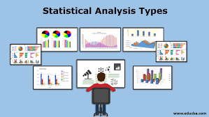
STATISTICS
Statistical data analysis is a procedure of performing various statistical operations. It is a kind of quantitative research, which seeks to quantify the data, and typically, applies some form of statistical analysis.

Slide 3
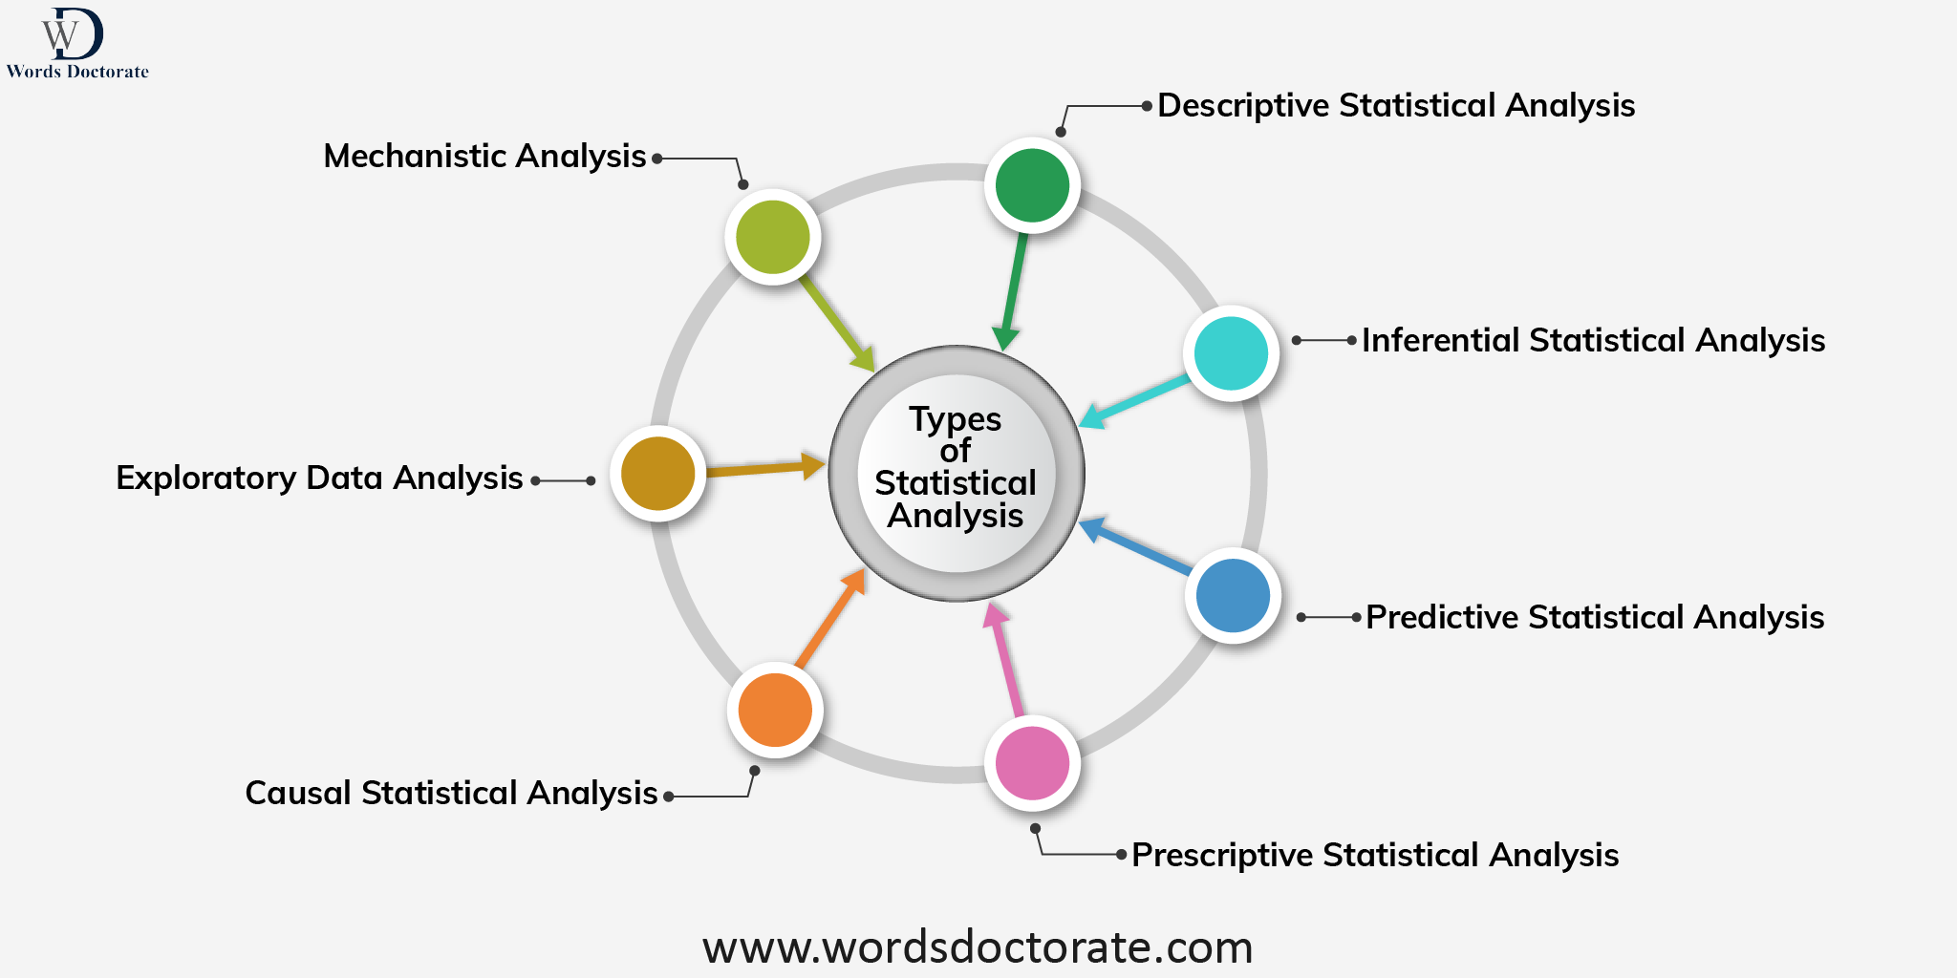

Slide 4
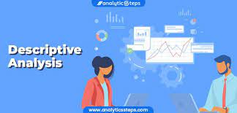
Descriptive Statistical Analysis
It deals with organizing and summarizing data using numbers and graphs. It makes easy the massive quantities of data for intelligible interpretation even without forming conclusions beyond the analysis or responding to any hypotheses.

Slide 5
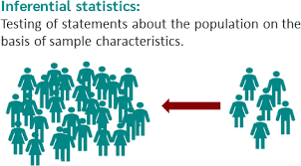
Inferential Statistical Analysis
The inferential statistical analysis basically is used when the inspection of each unit from the population is not achievable, hence, it extrapolates, the information obtained, to the complete population.

Slide 6
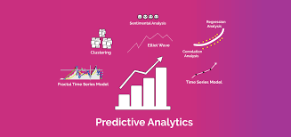
Predictive Analysis
Predictive analytics uses statistical techniques and machine learning algorithms to describe the possibility of future outcomes, behaviour, and trends depending on recent and previous data. Widely used techniques under predictive analysis include data mining, data modelling, artificial intelligence, machine learning and etc. to make imperative predictions.

Slide 7
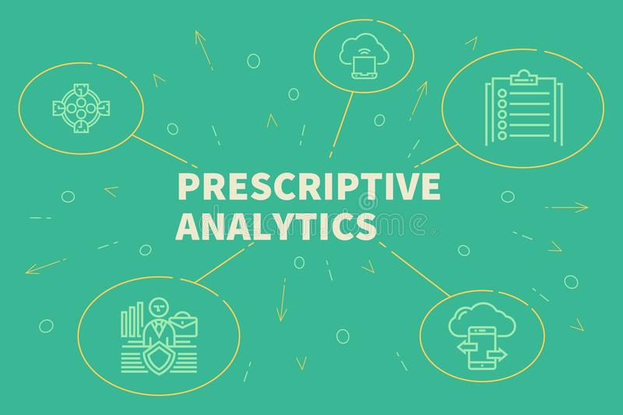
Prescriptive Analysis
The prescriptive analysis examines the data In order to find out what should be done, it is widely used in business analysis for identifying the best possible action for a situation.

Slide 8
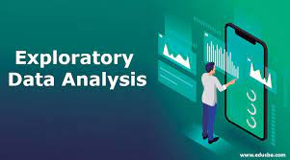
Exploratory Data Analysis (EDA)
Exploratory data analysis or EDA as it is known, is a counterpart of inferential statistics, and greatly implemented by data experts. It is generally the first step of the data analysis process that is conducted prior to any other statistical analysis techniques.

Slide 9
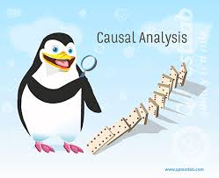
Causal Analysis
Causal analysis assists in understanding and determining the reasons behind “why” things occur, or why things are as such, as they appear.

Slide 10
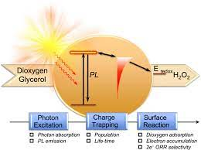
Mechanistic Analysis
Among the above statistical analysis, mechanistic is the least common type, however, it is worthy in the process of big data analytics and biological science. It is deployed to understand and explain how things happen rather than how specific things will take place ulteriorly.

Slide 11
THANK YOU

